Slide 1
21st February 2025
US CRM Roadmap
First Connect

Slide 2
MVP 0 Deliverables
Minimum Expectations – (36/56)
Nice to Have – (10/13)
EPIC | Features
Account Set Up | Dist. Company Contacts
Account Management | Create/manage profiles
Account Management | Policy Documents
Account Management | - Key Dist Contacts
Tools and Training | Selling Tools / Aids
Tools and Training | Service training
Tools and Training | CDOC videos
Tools and Training | SOPs
Tools and Training | Service training calendar
Tools and Training | Webinars
Tools and Training | Marketing Tools & JPG Files
Tools and Training | Value Proposition Presentations
Technical Product Information | Technical Data sheets
Technical Product Information | G/A Drawings
Technical Product Information | Parts & Operators Manuals by FAB#
Technical Product Information | One pagers - sales aides
EPIC | Features
Technical Product Information | Sales Flyers - PDF versions
Technical Product Information | Machine series info
Technical Product Information | Install requirements by frame
Technical Product Information | CAGI Performance Data Pages
Marketing | Leads
Marketing | Trade show stuff
Marketing | Case Studies
Marketing | Lead tracking and dashboard
Quote Generators | Machine configurator
Quote Generators | Freight Quote
Quote Generators | PM Parts Lookup and quote tool by FAB#
Service/Warranty | Service Documents
Service/Warranty | Warranty documents
Service/Warranty | Service Bulletins
Service/Warranty | Commissioning Instructions
Service/Warranty | Oil sample history and Data
Service/Warranty | PM Kits Tables
Service/Warranty | Parts ID & Request by Fab#
Admin Center | Contacts
Admin Center | Distributor Finder
EPIC | Features
Quote Generators | System recommendation intelligence
Quote Generators | - input system need / System auto selected
Quote Generators | Quote output into Word for customization
Quote Generators | - local pricing by % or $ margin calc
Quote Generators | - default margin can be set by Dist Mgmt
Quote Generators | Quote saving for future up-dating
Quote Generators | Engineered to build (Specials) Request Form
EPIC | Features
Service/Warranty | Database of Installations by customer site
Service/Warranty | - Key site data
Service/Warranty | - Unit data / avg hours per yr

Slide 3
MVP 1 Deliverables
Minimum Expectations (46/56)
Nice to Have (13/13)
EPIC | Features
Account Management | Accounting
Account Management | Accounts Receivable Details
Account Management | Credit Memos
Account Management | Invoice Retrieval
Order Management | Open Orders
Order Management | Purchase Order History
Order Management | Order Status & Tracking
Order Management | Shipment Tracking Data
Service/Warranty | Warranty Registration
Service/Warranty | Warranty Status
EPIC | Features
Account Set Up | Territory Map
Account Management | Performance/KPI Dashboard
Admin Center | Help ticket/feedback

Slide 4
MVP 2 Deliverables
Minimum Expectations (56/56)
EPIC | Features
Marketing | SWAG Ordering
Shopping Cart | Parts order entry
Shopping Cart | Equipment Order entry
Shopping Cart | PO / Order Submission
Shopping Cart | Price Books (exportable)
Shopping Cart | Inventory/ Lead timetables
Admin Center | Newsletters
Admin Center | Calendar / Key Dates
Admin Center | ELGi SWAG Store
Admin Center | Communications

Slide 5
To Be Discovered
Minimum Expectations
EPIC | Features
Marketing | SWAG Ordering
Shopping Cart | Parts order entry
Shopping Cart | Equipment Order entry
Shopping Cart | PO / Order Submission
Shopping Cart | Price Books (exportable)
Shopping Cart | Inventory/ Lead timetables
Admin Center | ELGi SWAG Store

Slide 6



Project Status:
ESFa – North America
To be started
2025 |  |  |  |  |  |  |  |  |  |  | 2026
Feb | Mar | Apr | May | Jun | Jul | Aug | Sep | Oct | Nov | Dec | Jan | Feb
MVP 0 – NA Go-Live
MVP 1 – NA Go-Live
MVP 2 – NA Go-Live
NA CRM Environment Readiness
MVP 0 – NA Dev Completion
MVP 1 – NA Dev Completion
MVP 2 – NA Dev Completion
MVP 0 – IN Completion
MVP 1 – IN Completion
Risk
Upcoming Milestones
Support Needed
Existing Data Migration
Cloud ERP Integration
Project Approval
Project team formation
1. Discovery of Shopping Cart Module
Legend
Initiation
Development
Testing
(UAT)
Milestones
Go-Live

Slide 7

Events
Stand -Up
Frequency – Daily
Governance
Frequency – Weekly
Members – All project members
Steering Committee
Frequency – 3 Week once
Members – Leadership + All Project members
Members – All project members
Sprint Review & Demo
Frequency – End of each Sprint
Member – All Project members
AGILE Project Management
Sprint Cycle
2 Weeks

Slide 8
Cost
Storage |  |  | Conversion ($)
Dataverse | 200 GB | 70,00,000.00 | 81395
Log | 50GB | 6,00,000.00 | 6977
File Storage | 200 GB | 1,00,000.00 | 1163
License |  |  | Conversion ($)
Sales | User | 60,000.00 | 698
Service | User | 60,000.00 | 698
 |  | Grand Total | 90930
* All the cost above mentioned are based on previous contract

Slide 9
“As Is”, Short Term & Long Term (Draft)
Business Units | CRM (As Is) | PIM (Product Information mgt System) (As Is) | Dealer Management System (As Is) | Short Term | Long Term
ELGi Industrials | ESFa Lite (PitchBook) - Dev | C-Doc | ELGI USA Dealer Portal | ESFa Lite (Lead, Opp, Accounts, Pitchbook and Quote) | ESFa (D365)
ELGi Portables | Salesforce | C-Doc | Salesforce | SalesForce | ESFa (D365)
Distribution Operations (MAS and Pattons INC) | ESFa Lite (Quote Module) - UAT | C-Doc | x | ESFa Lite (Lead, Opp, Accounts and Quote) | ESFa (D365)
Pattons Medical | ESFa Lite (UAT) Standalone Quote App | Pattons Medical Website / Sharepoint | NA | ESFa Lite (Lead, Opp, Accounts and Quote) | ESFa (D365)

Slide 10
Cost Structure PowerApps
Power Apps Premium
$20.00 user/month
Unlimited Power Apps and Power Pages for assigned user
500 AI Builder credits1
Use prebuilt, custom, and on-premises connectors
Dataverse entitlements of 250 MB database and 2 GB file

Slide 11
Cost Structure D365
Dynamics CRM - D365
~$60.00 user/month for ELGi Users
~$6.00 user/month for Dealers

Slide 12
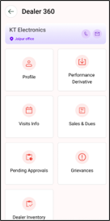
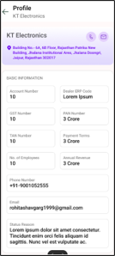
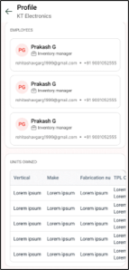
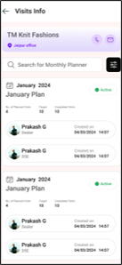
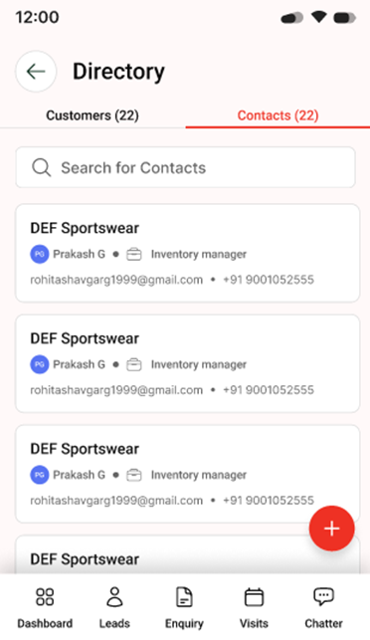
Distributor Portal (Account Setup)
Credit Application, Payment terms, Account Number/Sales Rep, Territory Map, Dist. Company Contacts

Slide 13
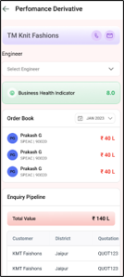
Account Management(Invoice Retrievals, Accounts Receivable Details)

Slide 14
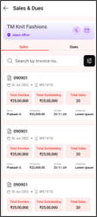
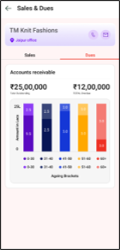
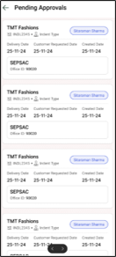
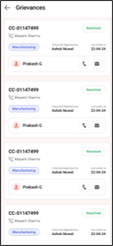
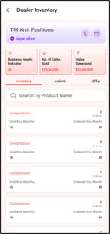
Account Management(Invoice Retrievals, Accounts Receivable Details)

Slide 15
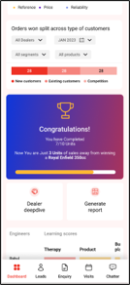
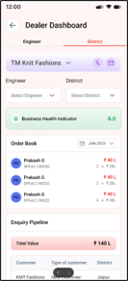
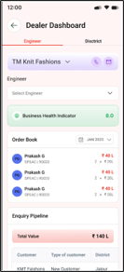
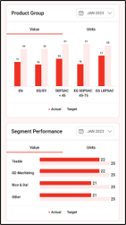
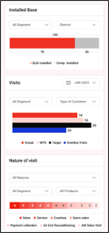
Account Management(Performance/KPI Dashboards)

Slide 16
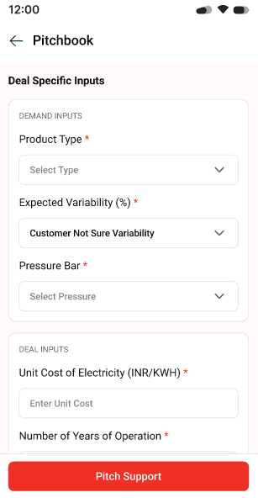
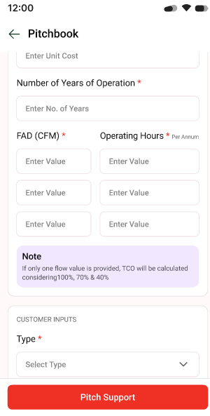
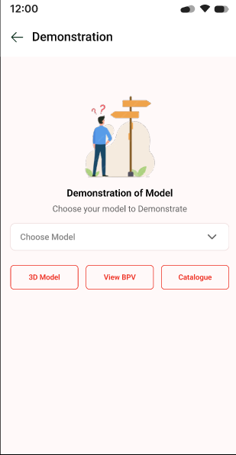
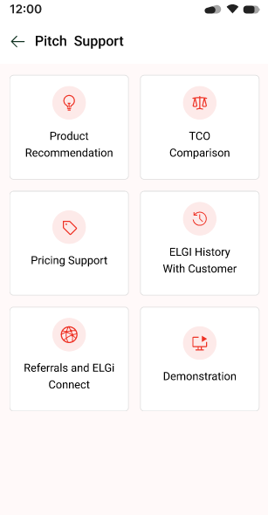
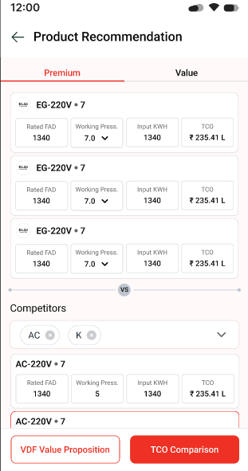
Tools and Trainings / Technical Product Information

Slide 17

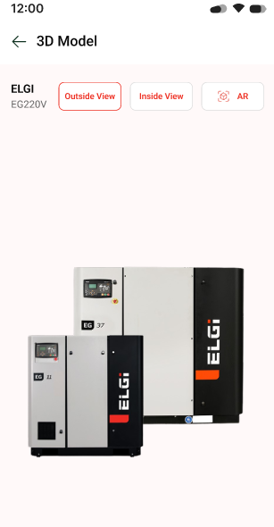
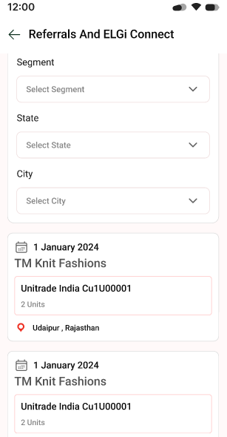
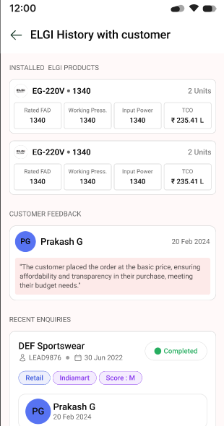
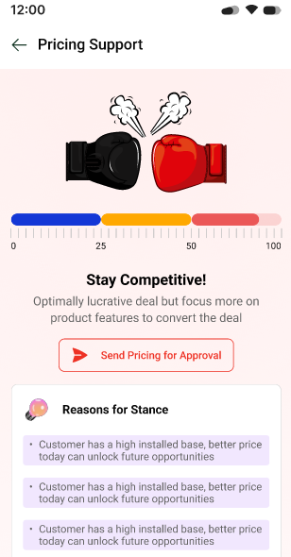
Tools and Trainings / Technical Product Information

Slide 18
Tools and Trainings / Technical Product Information

Slide 19
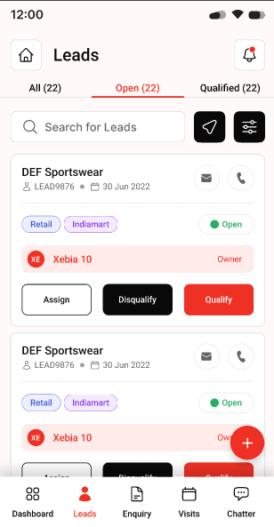
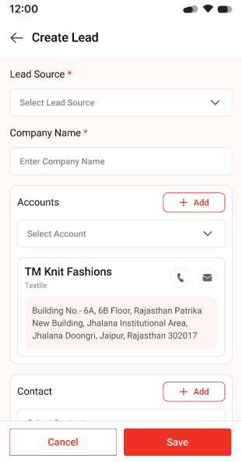
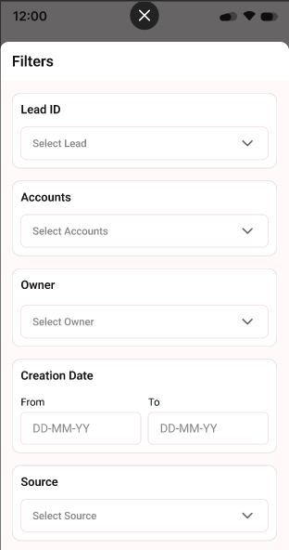
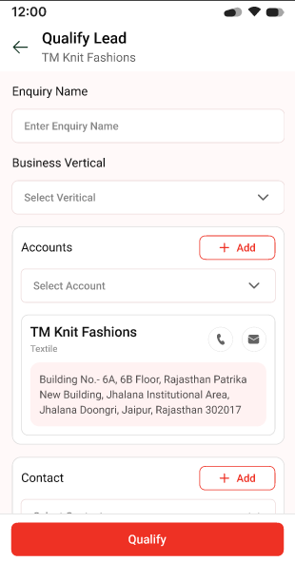
Lead Management

Slide 20
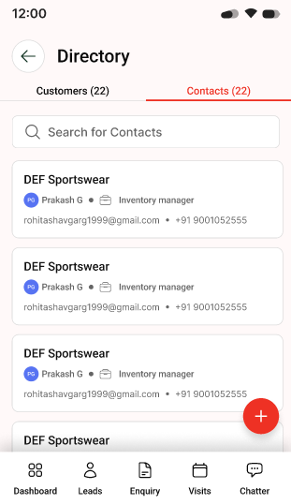
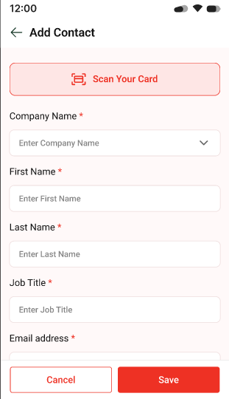
Contacts

Slide 21
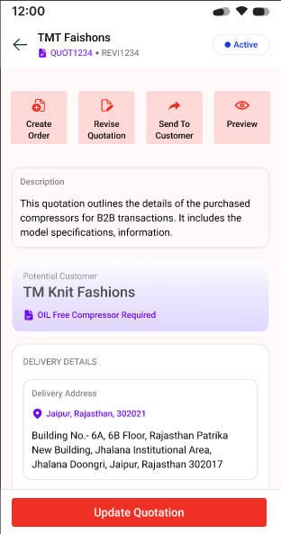
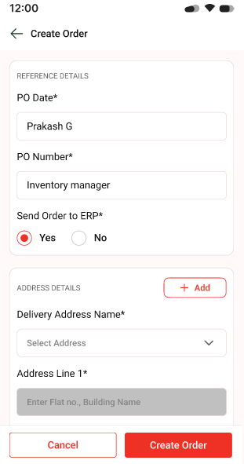
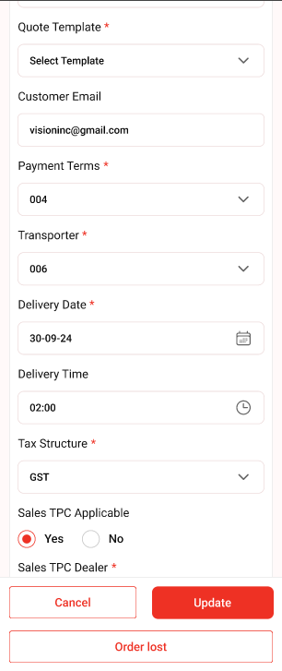
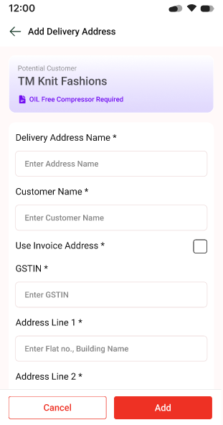
Order

Slide 22
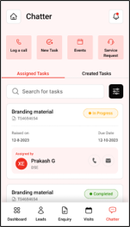
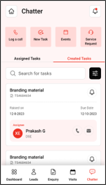
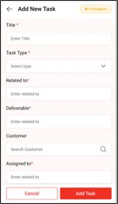
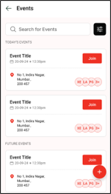
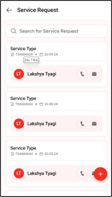
Chatter and Calender

Slide 23
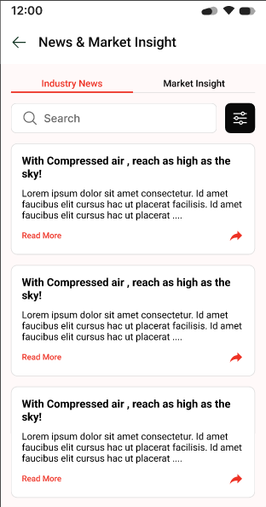
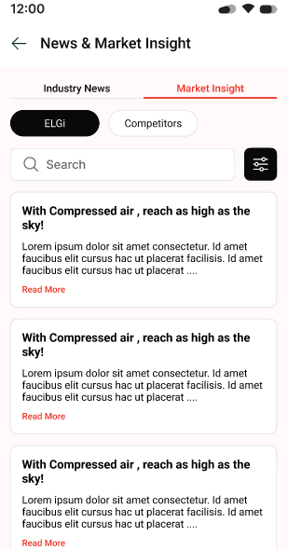
ELGi(Newsletters)

Slide 25
MVP 1
MVP 0
EPIC | Features
Account Set Up | Dist. Company Contacts
Account Management | Create/manage profiles
Account Management | Policy Documents
Account Management | - Key Dist Contacts
Tools and Training | Selling Tools / Aids
Tools and Training | Service training
Tools and Training | CDOC videos
Tools and Training | SOPs
Tools and Training | Service training calendar
Tools and Training | Webinars
Tools and Training | Marketing Tools & JPG Files
Tools and Training | Value Proposition Presentations
Technical Product Information | Technical Data sheets
Technical Product Information | G/A Drawings
Technical Product Information | Parts & Operators Manuals by FAB#
Technical Product Information | One pagers - sales aides
Technical Product Information | Sales Flyers - PDF versions
Technical Product Information | Machine series info
Technical Product Information | Install requirements by frame
Technical Product Information | CAGI Performance Data Pages
Marketing | Leads
Marketing | Trade show stuff
Marketing | Case Studies
Marketing | Lead tracking and dashboard
Quote Generators | Machine configurator
Quote Generators | Freight Quote
Quote Generators | PM Parts Lookup and quote tool by FAB#
Service/Warranty | Service Documents
Service/Warranty | Warranty documents
Service/Warranty | Service Bulletins
Service/Warranty | Commissioning Instructions
Service/Warranty | Oil sample history and Data
Service/Warranty | PM Kits Tables
Service/Warranty | Parts ID & Request by Fab#
ELGi | Contacts
ELGi | Distributor Finder
MVP 1
EPIC | Features
Account Management | Accounting
Account Management | Accounts Receivable Details
Account Management | Credit Memos
Account Management | Invoice Retrieval
Order Management | Open Orders
Order Management | Purchase Order History
Order Management | Order Status & Tracking
Order Management | Shipment Tracking Data
Service/Warranty | Warranty Registration
Service/Warranty | Warranty Status
MVP 2
EPIC | Features
Marketing | SWAG Ordering
Shopping Cart | Parts order entry
Shopping Cart | Equipment Order entry
Shopping Cart | PO / Order Submission
Shopping Cart | Price Books (exportable)
Shopping Cart | Inventory/ Lead time Tables
ELGi | Newsletters
ELGi | Calendar / Key Dates
ELGi | ELGi SWAG Store
ELGi | Communications

